Slide 1
University of Basrah
Al-Zahraa Medical College
Ministry of higher Education and Scientific Research
Academic year 2021-2022
5th year
REPRODUCTIVE BLOCK
Lecture
Duration : 1 hour
Postpartum haemorrhge
Presented by
Dr.RAYA MUSLIM AL HASSAN
Block staff:
Dr.Raya Muslim Al Hassan (Block leader)
Dr.Marwa Sadik (co leader)
Dr. Abdul kareem Hussain Subber
Dr.Alaa Hufdhi
GYNAECOLOGY 20th
EDITION by Ten Teachers

Slide 2
Learning objectives
University of Basrah
Al-Zahraa Medical College
Ministry of higher Education and Scientific Research
1- To understand postpartum haemorrhage(PPH)
2- Identify the risk factors of PPH
3- TO know the proper management of PPH

Slide 3
University of Basrah
Al-Zahraa Medical College
Ministry of higher Education and Scientific Research
PPH is the loss of 500 ml or more of blood from the genital tract within 24 hours of the birth of a baby until 12 weeks postnatally .It can be :
a/minor (500–1000 ml)
B/ major (more than 1000 ml).
Primary ( bleeding within the first 24 hours of delivery)
Secondary(after 24 hours until 12 weeks)

Slide 4
Causes of PPH
University of Basrah
Al-Zahraa Medical College
Ministry of higher Education and Scientific Research
It can be summarized in 4Ts:
Tone( uterine inertia) which is the commonest cause,the risk factors are:
Multiple pregnancy
Previous PPH
Failure to progress in second stage
Prolonged third stage of labour
General anaesthesia
APH
Trauma:perineal laceration/episiotomy/rupture uterus
Tissue: Retained placental,Placenta accrete
Thrombin…preeclampsia/bleeding disorders

Slide 5
management
University of Basrah
Al-Zahraa Medical College
Ministry of higher Education and Scientific Research
Measures for minor PPH
(blood loss 500–1000 ml) without clinical shock:
intravenous access (one 14-gauge cannula)
urgent venepuncture (20 ml) for:–group and screen–full blood count–coagulation screen, includingfibrinogen
pulse, respiratory rate and blood pressure recording every 15 minutes
commence warmed crystalloid infusion.

Slide 6
University of Basrah
Al-Zahraa Medical College
Ministry of higher Education and Scientific Research
Measures for major PPH
Full protocol for major PPH (blood loss greater than 1000 ml) and continuing to bleed or clinical shock
A and B–assess airway and breathing
C–evaluate circulation
position the patient flat keep the woman warm using appropriate available measures .
transfuse blood as soon as possible, if clinically required until blood is available, infuse up to 3.5 l of warmed clearfluids, initially 2 l of warmed isotonic crystalloid. Further fluid resuscitation can continue with additional isotonic crystalloid or colloid(succinylated gelatin). Hydroxyethyl starch should not be used. the best equipment available should be used to achieve rapid warmed infusion of fluids. special bloodfilters should not be used, as they slow infusions.
Treating the cause

Slide 7
Treatment of uterine inertia
University of Basrah
Al-Zahraa Medical College
Ministry of higher Education and Scientific Research
palpate the uterine fundus and rub it to stimulate contractions (‘rubbing up the fundus’) .
ensure that the bladder is empty (Foley catheter, leave in place) .
oxytocin 5 iu by slow intravenous injection (may have repeat dose) .
ergometrine 0.5 mg by slow intravenous or intramuscular injection (contraindicated in women with hypertension) .
oxytocin infusion (40 iu in 500 ml isotonic crystalloids at 125 ml/hour) unless fluid restrictionis necessary .
carboprost 0.25 mg by intramuscular injection repeated at intervals of not less than 15 minutes to a maximum of eight doses (use with caution in women with asthma) .
misoprostol 800 micrograms sublingually.

Slide 8
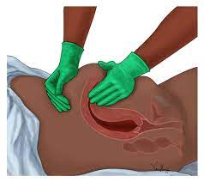

Slide 9
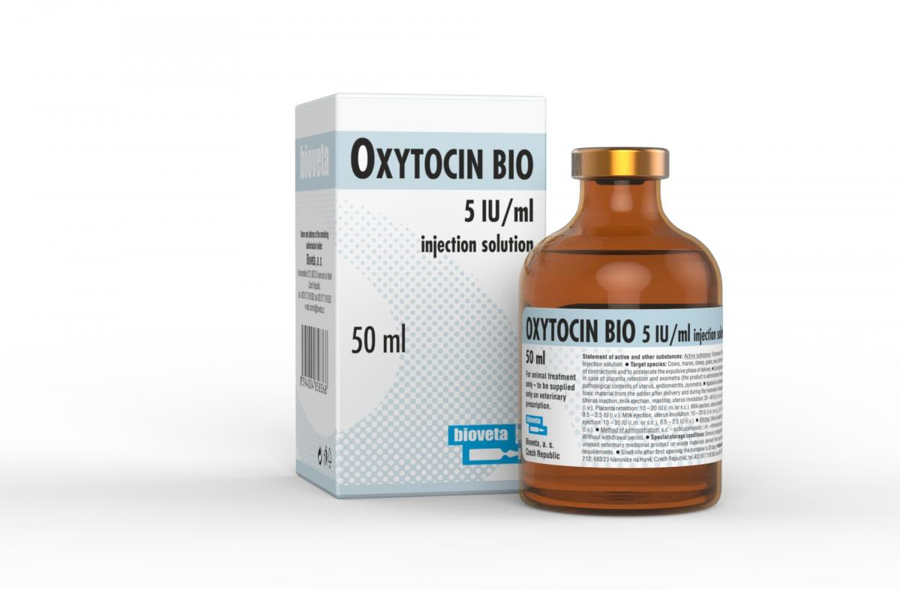
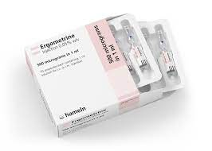
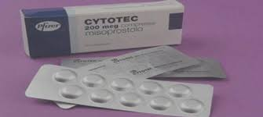

Slide 10
University of Basrah
Al-Zahraa Medical College
Ministry of higher Education and Scientific Research
If the drugs failed , so proceed for surgical measures:
Intrauterine balloon
B-Lynch
Uterine artery ligation
Internal iliac artery ligation
Hysterectomy
Uterine artery embolization

Slide 11
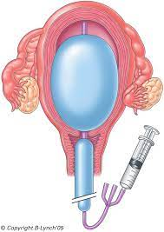

Slide 12
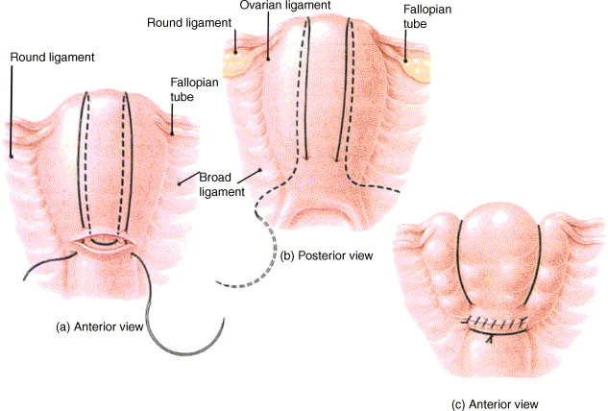

Slide 13
University of Basrah
Al-Zahraa Medical College
Ministry of higher Education and Scientific Research
Management of other causes
??????

Slide 14
University of Basrah
Al-Zahraa Medical College
Ministry of higher Education and Scientific Research
How should secondary PPH be managed?
In women presenting with secondary PPH, an assessment of vaginal microbiology should be performed (high vaginal and endocervical swabs) and appropriate use of antimicrobial therapy should be initiated when endometritis is suspected.
A pelvic ultrasound may help to exclude the presence of retained products of conception(RPOC) .

Slide 15
complications
University of Basrah
Al-Zahraa Medical College
Ministry of higher Education and Scientific Research
Shock
DIC
Renal failure
Sepsis
death

